Slide 1
Wake Panel Method
Kat Hernandez
May 1, 2014
MAE 6226 Final Project

Slide 2
Different Techniques
Spatial wake relaxation
Time stepping method

Slide 3
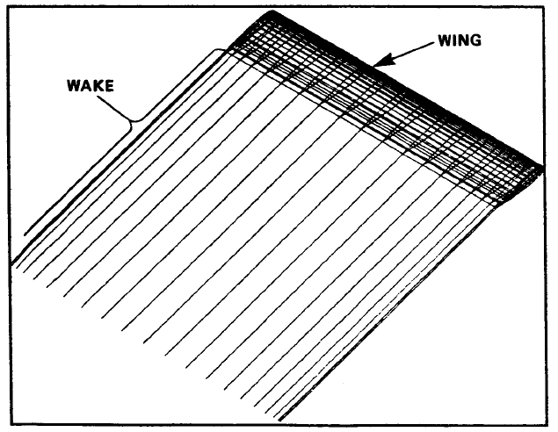
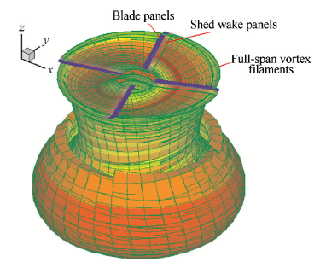
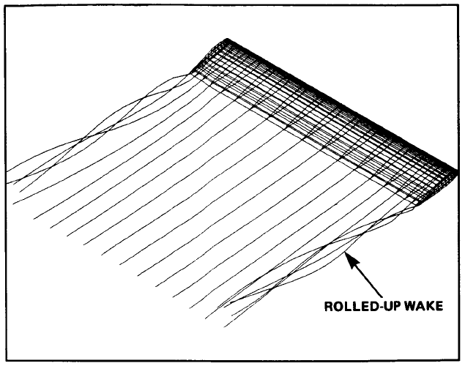
Applications
Wake panels prior to wake relaxation (Smith 1987)
Rotor Wake (Jianfeng 2012)
After wake relaxation (Smith 1987)

Slide 4
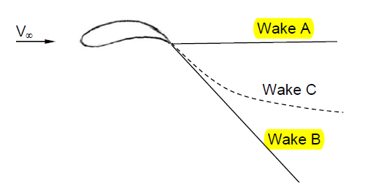
Wake Shapes
(Source: Bramesfield 2006)

Slide 5
Wake Shapes cont..
Wake A: Higher accuracy further downstream
Wake B: Higher accuracy closer to the trailing edge
Wake C: Calculation of induced drag becomes more complicated and conservation of momentum is not always enforced

Slide 6
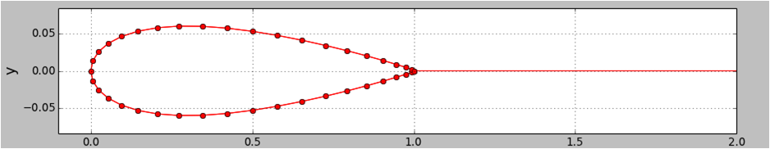
Discretize Geometry
Add wake panel to the definePanels function from lesson 11

Slide 7


Flow Tangency Boundary Condition
Neumman boundary condition
Where,
Type of panels used: Doublet Panels

Slide 8



Doublet Potential

Slide 9
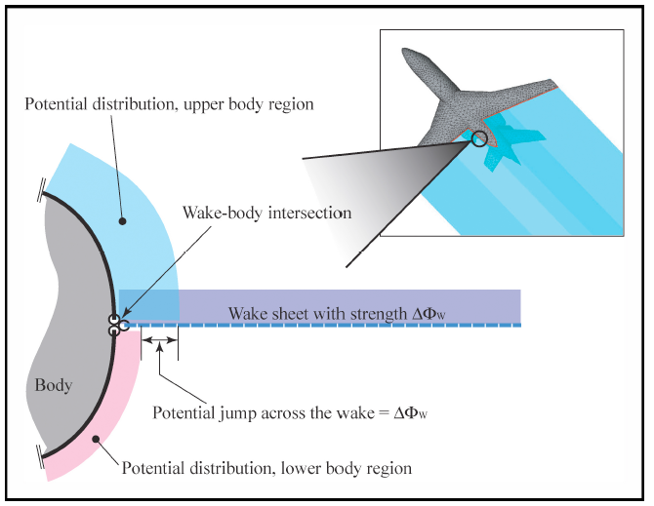
Enforcing the Kutta Condition with a wake panel

Slide 10
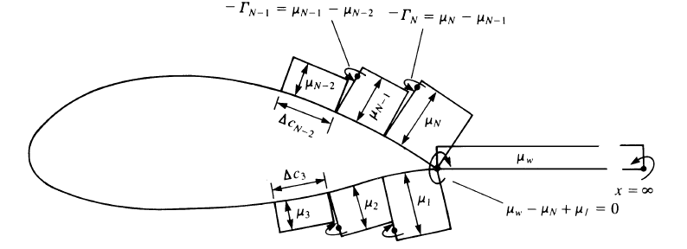
Enforcing the Kutta Condition with a wake panel cont..
Need zero circulation at the stagnation point
(Source: Katz 2001)

Slide 11
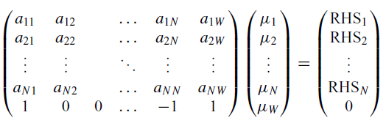
Building the linear system
Doublet Matrix, A
[N+1] x [N+1]
RHS, B
Free stream conditions
Unknown ➔ strength of doublets

Slide 12
Solving linear system & plotting stream lines
Use linalg.solve
Plot stream lines by obtaing u,v velocity components as done in lesson 11 challenge task

Slide 13
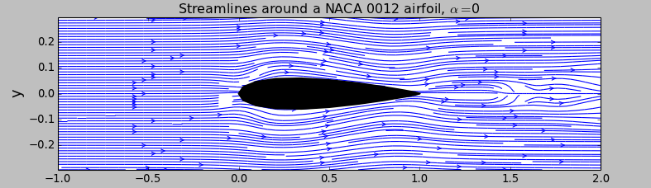
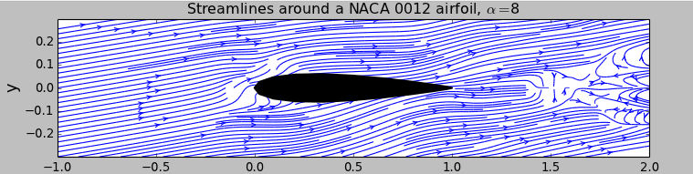
Results

Slide 14
Thank You!

